Slide 1
BIOM3015 Practical Module 1
Effect of Ghrelin on Ischemic Heart Disease
Bioinformatics and Molecular Investigations of Underlying Pathways

Slide 2
Module 1: Ischemic Heart Disease
Animal treatment and tissue collection:
Mice with coronary artery occluded or sham
Treated with synthetic ghrelin analogue or placebo
Mice sacrificed and ventricle frozen in liquid nitrogen
RNA extracted and cDNA synthesised
Online databases of microarray & seqRNA results analysed for genes of interest
In groups of 3-4 you will:
Perform pathway & literature searches and to select a gene of interest
Design primers for your gene
Perform qPCR and analyse the results
Individual report on your experimental findings (20%)
4 page limit (excluding reference list)
Submitted online through Turnitin (link on Blackboard)
Due in week 6 (1 week after final prac class)

Slide 3
Overview
Myocardial infarct -> pathological cardiac remodeling -> heart failure
Inhibited by ghrelin
Candidate pathways:
Inflammatory response (1)
Sympathetic nervous system response (2, 3)
Growth hormone mediated (4)

Slide 4
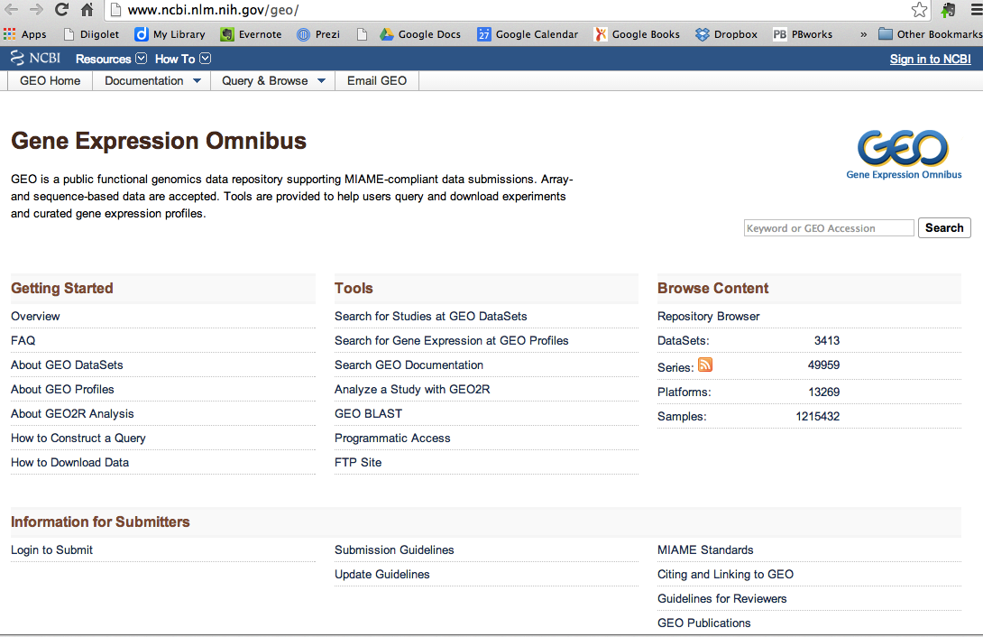
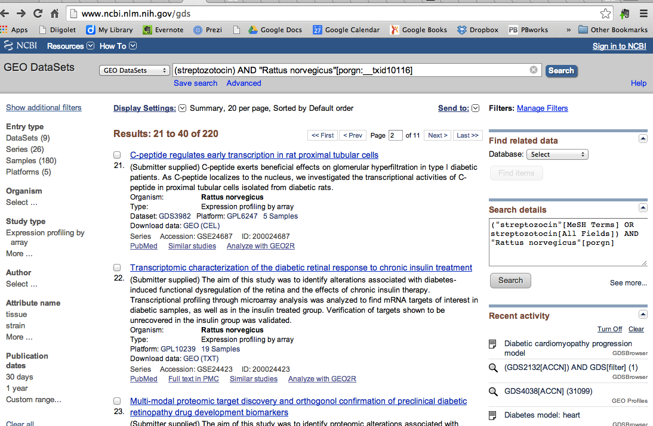
GEO Datasets: http://www.ncbi.nlm.nih.gov/geo/
Database of results from microarray and seqRNA experiments

Slide 5
Available data sets
Ghrelin:
Liver fibrosis – GDS, Abstract
Cardiac remodeling time courses post myocardial infarction
0h-48hr

Slide 6
NIH GEO
http://www.ncbi.nlm.nih.gov/gds
Searched for ‘ischemia heart mouse’ => 467 data sets
Post-ischemic heart failure model
Abstract
Paper
Differential gene expression profile in post-ischemic heart failure mouse hearts:
“A total of 14,755 distinct genes with known protein products were probed … 1989 (13.48%) were significantly up-regulated and 90 (0.61%) were down-regulated in post-ischemic HF hearts. Using the GenMapp software to categorize Gene Ontology terms, we examined whether certain cellular pathways encoded by altered genes were prominently affected in the infarcted myocardium… We validated by real-time PCR five of the genes that were found by the microarray analysis to be either up- (Hif1a, Ifnar1, Mmp23, and Tlr4) or not regulated (Nos2).”

Slide 7
Post-ischemic heart failure model
Analysis of C57BL/6 hearts 7 weeks after inducing myocardial infarction. Myocardial infarcts were produced by ligation of the descending branch of the left coronary artery.

Slide 8
Acute myocardial infarction model: time course (MG-U74C)
Analysis of left heart ventricles (LV) at various time points up to 48 hours following surgically induced acute myocardial infarction (AMI). Ischemic/infarcted tissue, surviving free wall, and the interventricular septum of LV examined.
Harpster MH, Bandyopadhyay S, Thomas DP, Ivanov PS et al. Earliest changes in the left ventricular transcriptome postmyocardial infarction. Mamm Genome 2006 Jul;17(7):701-15. PMID: 16845475
GDS2331[ACCN]
Notes:
#GSM104557 = Value for GSM104557: NaÃ¯ve LV, biological rep1, Cv2; src: C57/BL6 heart tissue
#GSM104558 = Value for GSM104558: NaÃ¯ve2 LV, biological rep1, Cv2; src: C57/BL6 heart tissue
#GSM104657 = Value for GSM104657: NaÃ¯ve LV, biological rep2, Cv2; src: C57/BL6 heart tissue
Sham LV:
#GSM104565 = Value for GSM104565: 15 min_LV Sham tissue, biological rep1, Cv2; src: C57/BL6 heart tissue
#GSM104664 = Value for GSM104664: 15 min_LV Sham tissue, biological rep2, Cv2; src: C57/BL6 heart tissue
#GSM104566 = Value for GSM104566: 60 min_LV Sham tissue, biological rep1, Cv2; src: C57/BL6 heart tissue
#GSM104665 = Value for GSM104665: 60 min_LV Sham tissue, biological rep2, Cv2; src: C57/BL6 heart tissue
#GSM104567 = Value for GSM104567: 4h_LV Sham tissue, biological rep1, Cv2; src: C57/BL6 heart tissue
#GSM104666 = Value for GSM104666: 4h_LV Sham tissue, biological rep2, Cv2; src: C57/BL6 heart tissue
#GSM104568 = Value for GSM104568: 12h_LV Sham tissue, biological rep1, Cv2; src: C57/BL6 heart tissue
#GSM104667 = Value for GSM104667: 12h_LV Sham tissue, biological rep2, Cv2; src: C57/BL6 heart tissue
#GSM104569 = Value for GSM104569: 24h_LV Sham tissue, biological rep1, Cv2; src: C57/BL6 heart tissue
#GSM104668 = Value for GSM104668: 24h_LV Sham tissue, biological rep2, Cv2; src: C57/BL6 heart tissue
#GSM104570 = Value for GSM104570: 48h_LV Sham tissue, biological rep1, Cv2; src: C57/BL6 heart tissue
#GSM104669 = Value for GSM104669: 48h_LV Sham tissue, biological rep2, Cv2; src: C57/BL6 heart tissue
Infarcted tissue:
#GSM104559 = Value for GSM104559: 15 min_post-AMI_IF tissue, biological rep1, Cv2; src: C57/BL6 heart tissue
#GSM104658 = Value for GSM104658: 15 min_post-AMI_IF tissue, biological rep2, Cv2; src: C57/BL6 heart tissue
#GSM104560 = Value for GSM104560: 60 min_post-AMI_IF tissue, biological rep1, Cv2; src: C57/BL6 heart tissue
#GSM104659 = Value for GSM104659: 60 min_post-AMI_IF tissue, biological rep2, Cv2; src: C57/BL6 heart tissue
#GSM104561 = Value for GSM104561: 4h_post-AMI_IF tissue, biological rep1, Cv2; src: C57/BL6 heart tissue
#GSM104660 = Value for GSM104660: 4h_post-AMI_IF tissue, biological rep2, Cv2; src: C57/BL6 heart tissue
#GSM104562 = Value for GSM104562: 12h_post-AMI_IF tissue, biological rep1, Cv2; src: C57/BL6 heart tissue
#GSM104661 = Value for GSM104661: 12h_post-AMI_IF tissue, biological rep2, Cv2; src: C57/BL6 heart tissue
#GSM104563 = Value for GSM104563: 24h_post-AMI_IF tissue, biological rep1, Cv2; src: C57/BL6 heart tissue
#GSM104662 = Value for GSM104662: 24h_post-AMI_IF tissue, biological rep2, Cv2; src: C57/BL6 heart tissue
#GSM104564 = Value for GSM104564: 48h_post-AMI_IF tissue, biological rep1, Cv2; src: C57/BL6 heart tissue
#GSM104663 = Value for GSM104663: 48h_post-AMI_IF tissue, biological rep2, Cv2; src: C57/BL6 heart tissue
Surviving free wall:
#GSM104583 = Value for GSM104583: 15 min_post-AMI_FW tissue, biological rep1, Cv2; src: C57/BL6 heart tissue
#GSM104682 = Value for GSM104682: 15 min_post-AMI_FW tissue, biological rep2, Cv2; src: C57/BL6 heart tissue
#GSM104584 = Value for GSM104584: 60 min_post-AMI_FW tissue, biological rep1, Cv2; src: C57/BL6 heart tissue
#GSM104683 = Value for GSM104683: 60 min_post-AMI_FW tissue, biological rep2, Cv2; src: C57/BL6 heart tissue
#GSM104585 = Value for GSM104585: 4h_post-AMI_FW tissue, biological rep1, Cv2; src: C57/BL6 heart tissue
#GSM104684 = Value for GSM104684: 4h_post-AMI_FW tissue, biological rep2, Cv2; src: C57/BL6 heart tissue
#GSM104586 = Value for GSM104586: 12h_post-AMI_FW tissue, biological rep1, Cv2; src: C57/BL6 heart tissue
#GSM104685 = Value for GSM104685: 12h_post-AMI_FW tissue, biological rep2, Cv2; src: C57/BL6 heart tissue
#GSM104587 = Value for GSM104587: 24h_post-AMI_FW tissue, biological rep1, Cv2; src: C57/BL6 heart tissue
#GSM104686 = Value for GSM104686: 24h_post-AMI_FW tissue, biological rep2, Cv2; src: C57/BL6 heart tissue
#GSM104588 = Value for GSM104588: 48h_post-AMI_FW tissue, biological rep1, Cv2; src: C57/BL6 heart tissue
#GSM104687 = Value for GSM104687: 48h_post-AMI_FW tissue, biological rep2, Cv2; src: C57/BL6 heart tissue
48hr:
#GSM104570 = Value for GSM104570: 48h_LV Sham tissue, biological rep1, Cv2; src: C57/BL6 heart tissue
#GSM104669 = Value for GSM104669: 48h_LV Sham tissue, biological rep2, Cv2; src: C57/BL6 heart tissue
#GSM104564 = Value for GSM104564: 48h_post-AMI_IF tissue, biological rep1, Cv2; src: C57/BL6 heart tissue
#GSM104663 = Value for GSM104663: 48h_post-AMI_IF tissue, biological rep2, Cv2; src: C57/BL6 heart tissue
#GSM104588 = Value for GSM104588: 48h_post-AMI_FW tissue, biological rep1, Cv2; src: C57/BL6 heart tissue
#GSM104687 = Value for GSM104687: 48h_post-AMI_FW tissue, biological rep2, Cv2; src: C57/BL6 heart tissue

Slide 9
Ghrelin
http://www.ncbi.nlm.nih.gov/geo/query/acc.cgi?acc=GSE13747

Slide 10
GenMAPP
Papers:
GenMAPP, a new tool for viewing and analyzing microarray data on biological pathways.
MAPPFinder: using Gene Ontology and GenMAPP to create a global gene-expression profile from microarray data.

Slide 11
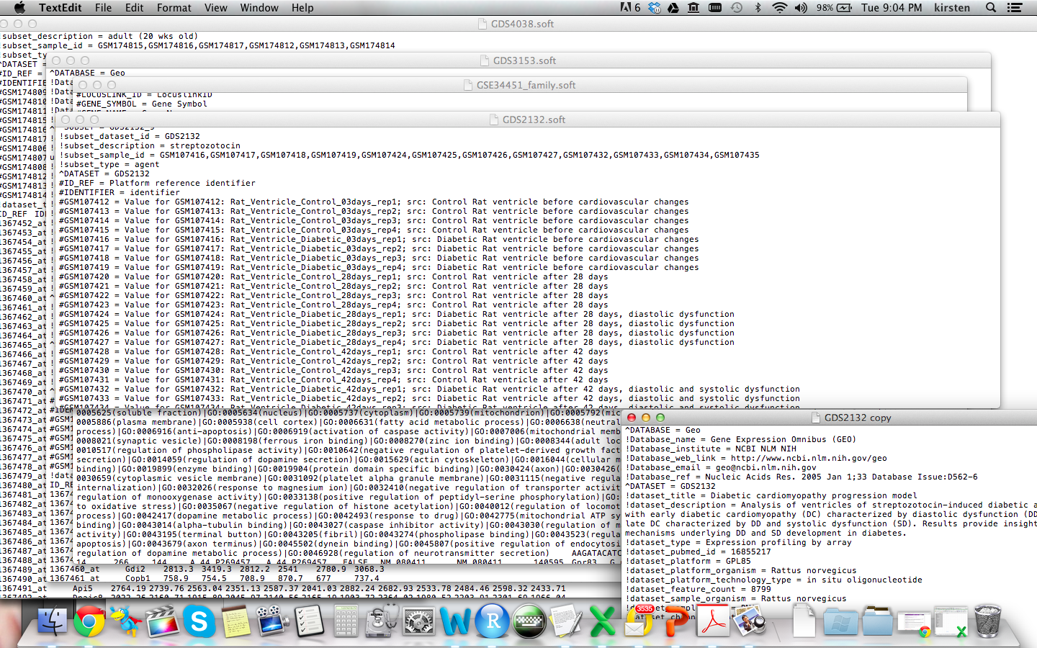
Soooooo many experiments!!!

Slide 12
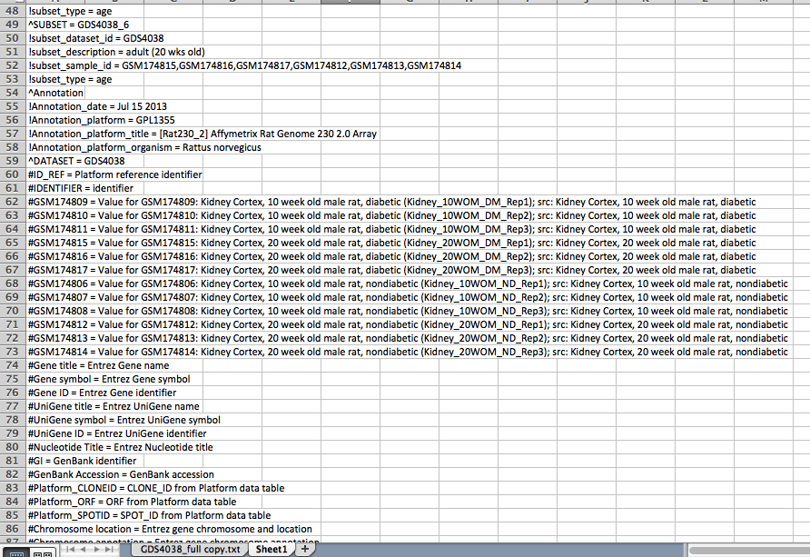
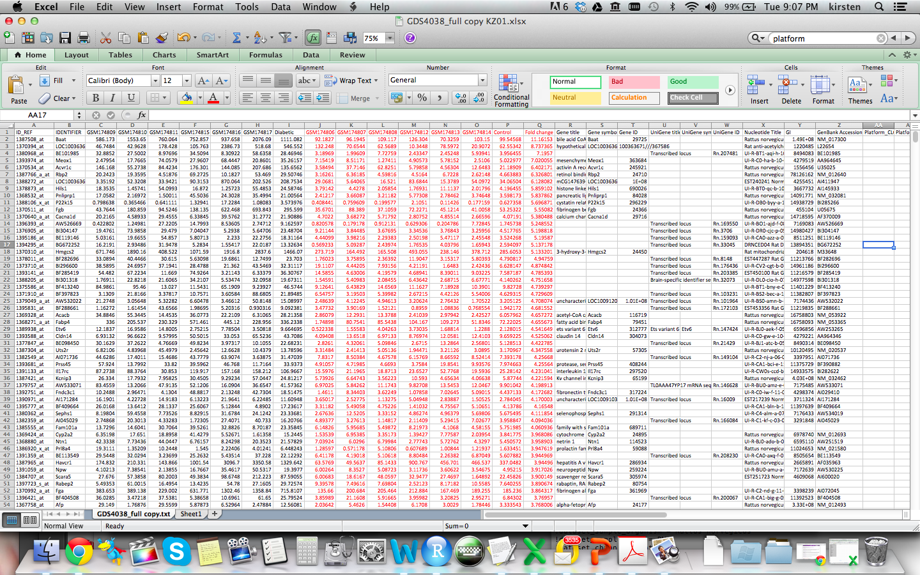
Soooooo much data!!!

Slide 13

So I got lost in the data for a while ;)
…then focused!
Data from
STZ models
in rodents
In the 3 tissues we have available
Brain
Heart
Kidney
Over a similar time course
3 data sets for each
Which genes have at least 2 fold change in expression?
Which of these genes turn up in more than 1 data set

Slide 14
So now we have our ‘top 100’ genes
Genes which were up-regulated
Twice as many copies of mRNA compared with control
Genes that were down regulated
less than half the expression of controls
Now how do you choose a single gene to investigate…?

Slide 15
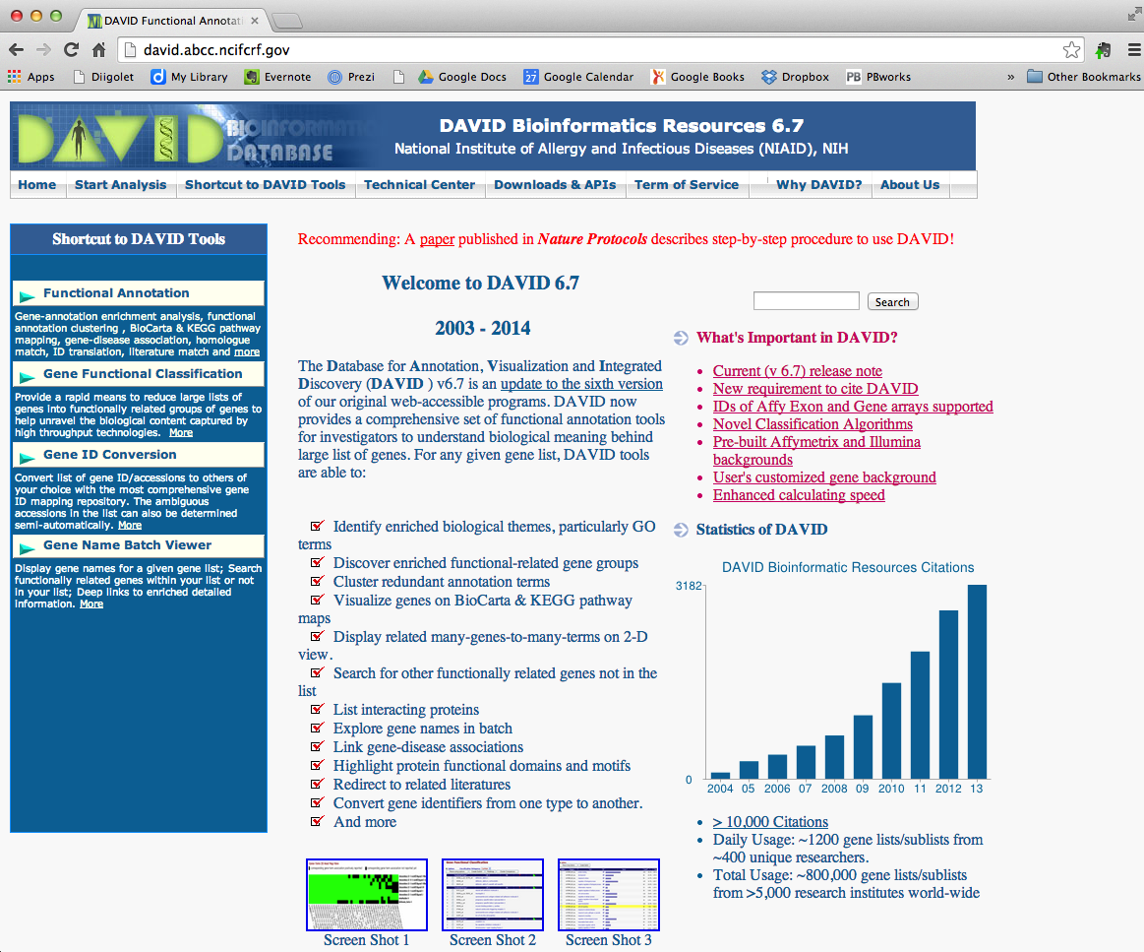
DAVID to the rescue!!!
http://david.abcc.ncifcrf.gov/
Database for Annotation, Visualisation & Integrated Discovery
…and many other sites like it – for review see:
Huang et al 2009 Nature Protocols 4: 44-57
Notes:
http://www.nature.com/nprot/journal/v4/n1/full/nprot.2008.211.html
Nature Protocols 4, 44 - 57 (2009) Published online: 18 December 2008 | doi:10.1038/nprot.2008.211
Subject Category: Computational and theoretical biology
Systematic and integrative analysis of large gene lists using DAVID bioinformatics resources
Da Wei Huang1,2, Brad T Sherman1,2 & Richard A Lempicki1
ABSTRACT
DAVID bioinformatics resources consists of an integrated biological knowledgebase and analytic tools aimed at systematically extracting biological meaning from large gene/protein lists. This protocol explains how to use DAVID, a high-throughput and integrated data-mining environment, to analyze gene lists derived from high-throughput genomic experiments. The procedure first requires uploading a gene list containing any number of common gene identifiers followed by analysis using one or more text and pathway-mining tools such as gene functional classification, functional annotation chart or clustering and functional annotation table. By following this protocol, investigators are able to gain an in-depth understanding of the biological themes in lists of genes that are enriched in genome-scale studies.
Supplementary Data 1. Collection of 68 similar enrichment analysis tools. The tools are roughly categorized into three classes according to their backend algorithms. Reference links are provided for more information about each tool.
Others like DAVID eg http://cbl-gorilla.cs.technion.ac.il/GOrilla/8ynkxheq/GOResults.html – much simpler interface and pathway maps but mostly on function of GOI product, not specific pathway?
http://www.ncbi.nlm.nih.gov/gene – from GK - may be of help
http://rgd.mcw.edu/ = rat genome dateabase

Slide 16
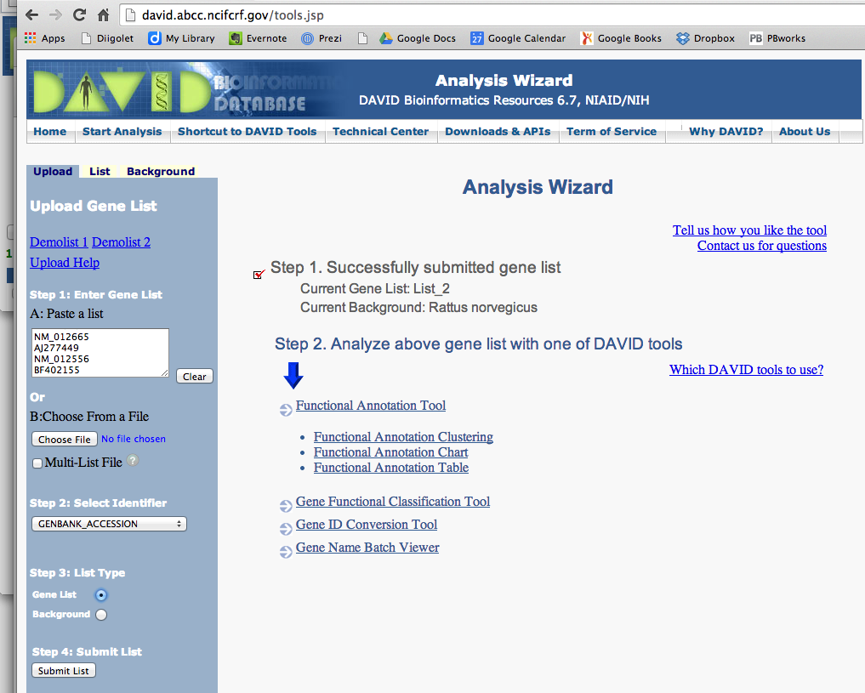
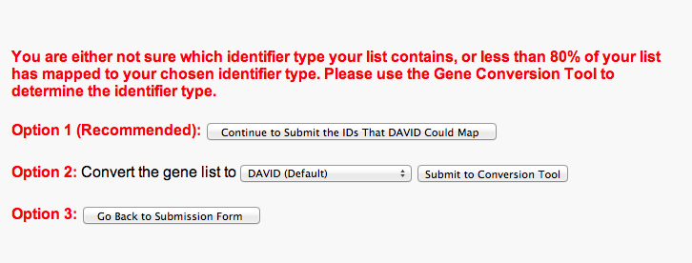
Load in our top 100 genes…
…and DAVID will tell us what ‘biological meaning/themes’ are present in the list…

Slide 17
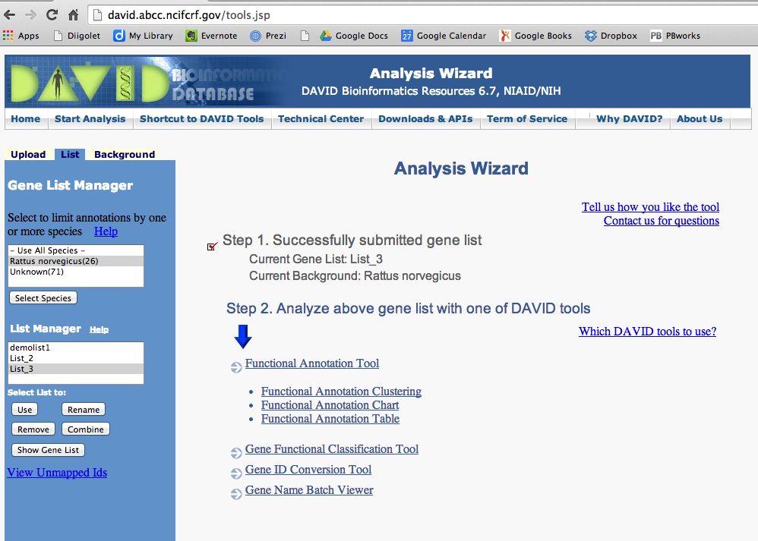
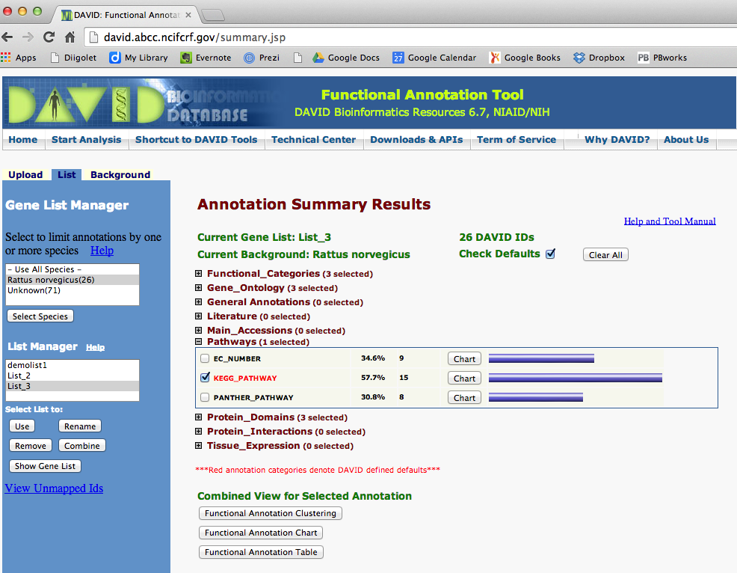
Several different ways to look at overlap between genes within the top 100 list
Functional Annotation Cluster
Many different ways to group the genes
Pathways…
click on “Chart” button

Slide 18
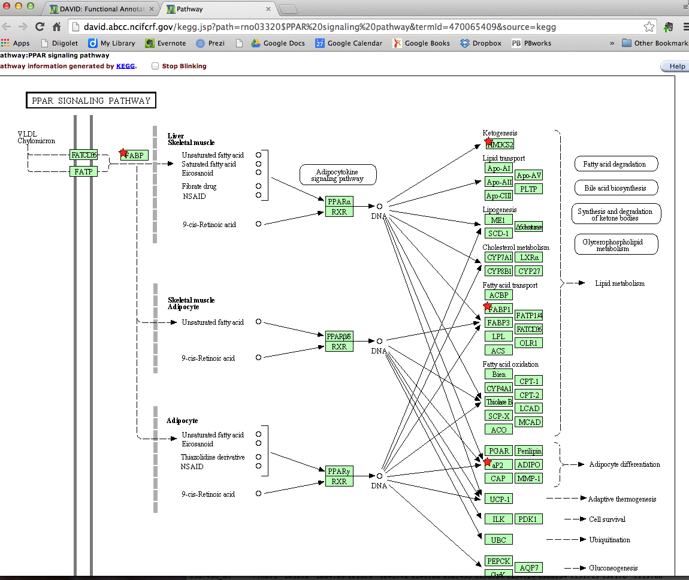
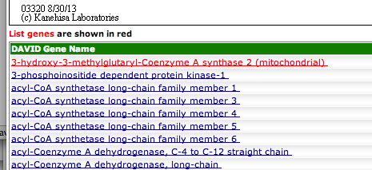
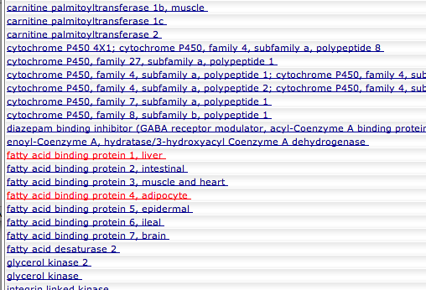
And the stars appear…
The red stars indicate genes in that pathway that were on our top 100 list

Slide 19
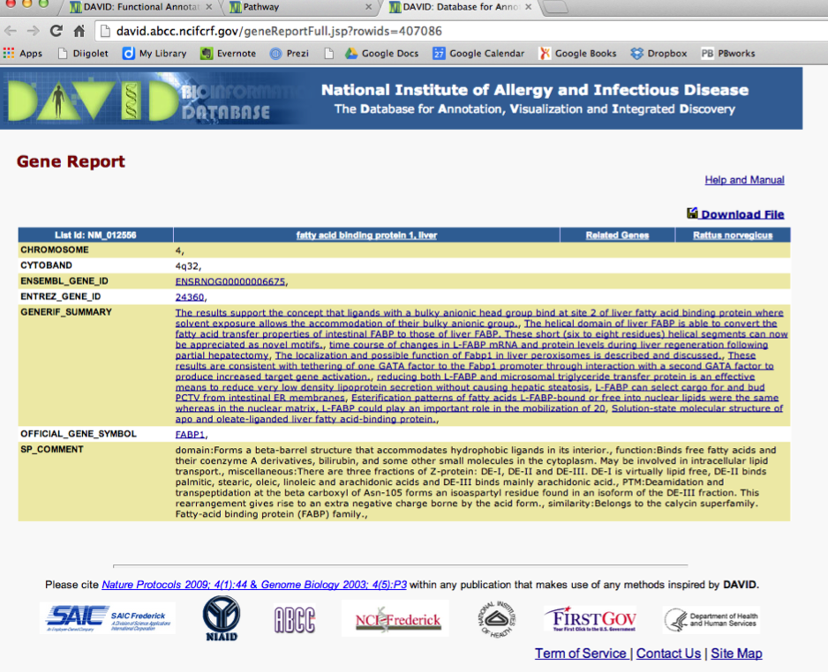
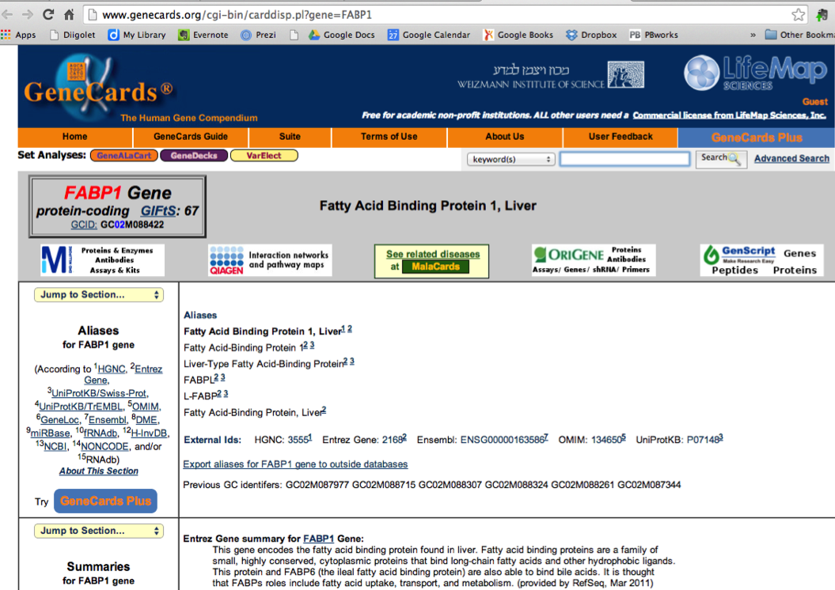
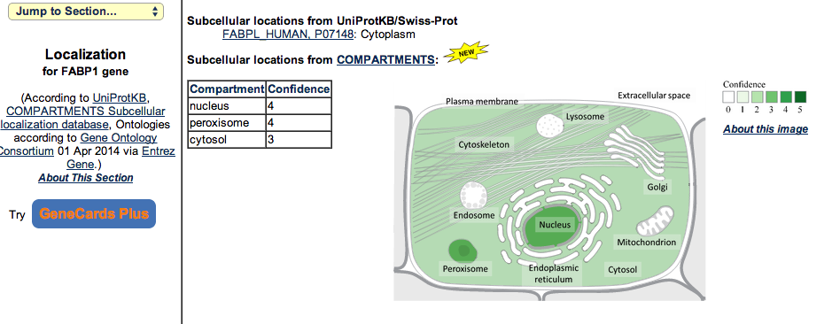
… and then gives you more gene information than you could imagine
Supplement this with
our old favourite:
PUBMED

Slide 20
Selecting your tissue & gene
Choose 1 tissue to investigate
Download top 100 gene list from Blackboard
Paste into DAVID - http://david.abcc.ncifcrf.gov/
A pathway/function that interests you and can be relatively easily linked to diabetes model
Some evidence from literature that pathway or functions are relevant
Choose 1 gene to investigate
Find novel candidate that has not be investigated in this model before
Then choose primers for your gene of interest (GOI)…

Slide 21
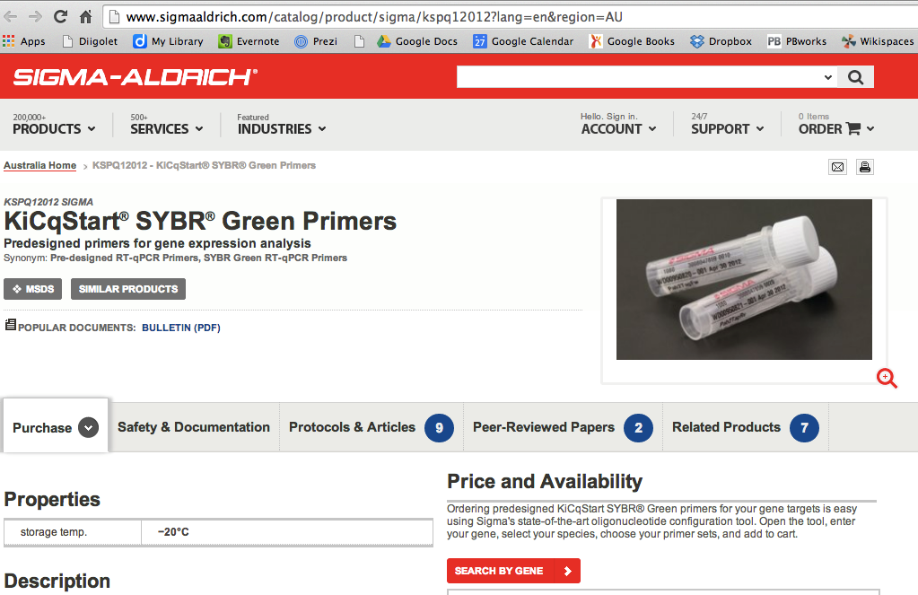
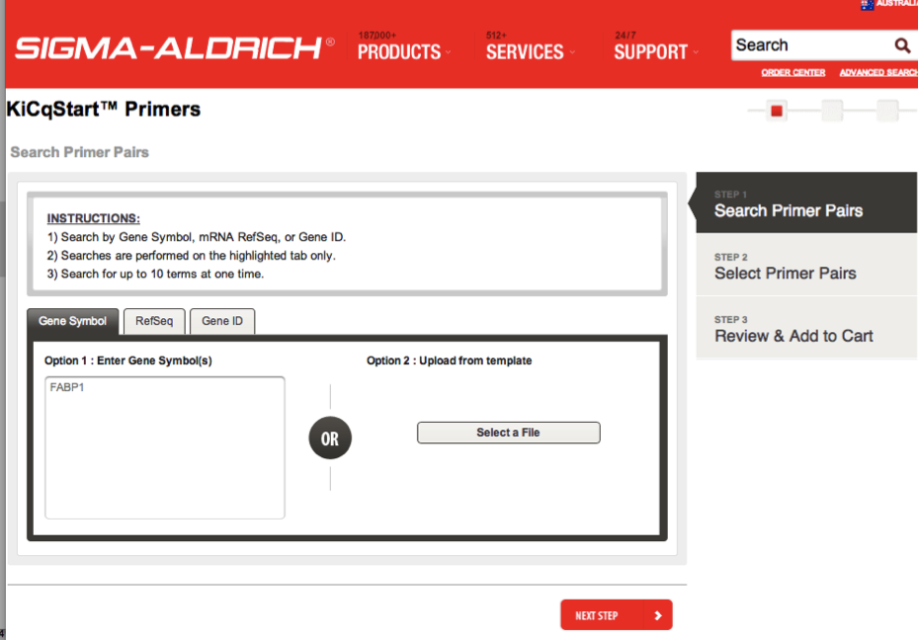
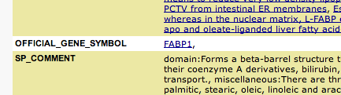
Choosing and ordering your primers
https://kicqstart-primers-sigmaaldrich.com/KiCqStartPrimers.php

Slide 22
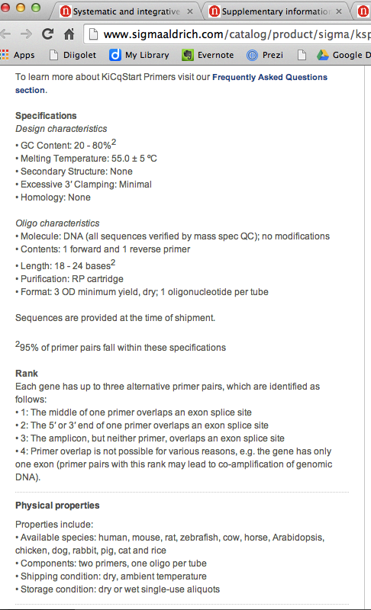
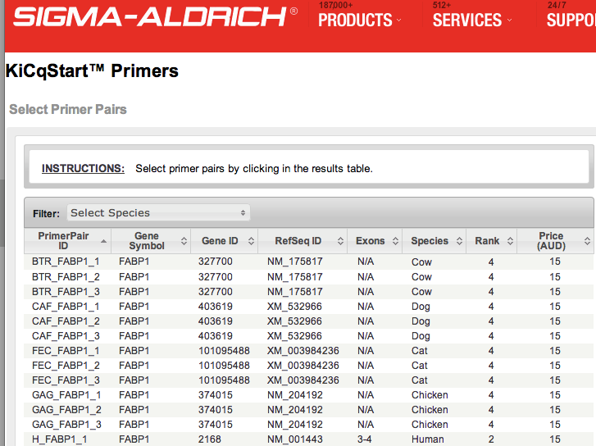
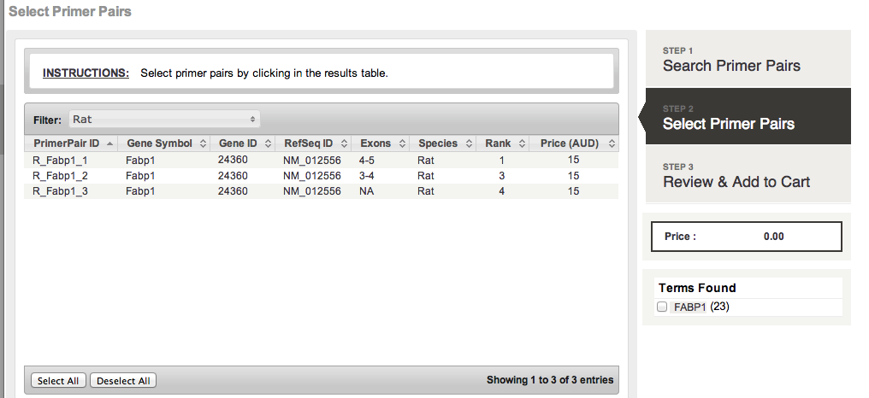
What makes a good primer pair?
Email your selection to me: k.zimbardi@uq.edu.au

